Slide 1

IoT-Based Smart Parking System Using Raspberry Pi
Computer and Communication Engineering (CCE)
19CCE301 Internet of Things

Slide 2
CCE Team 9
Name | Roll Number
B Ambareesh | CB.EN.U4CCE20006
Narendran S | CB.EN.U4CCE20036
Pabbathi Greeshma | CB.EN.U4CCE20040
Santosh | CB.EN.U4CCE20053

Slide 3
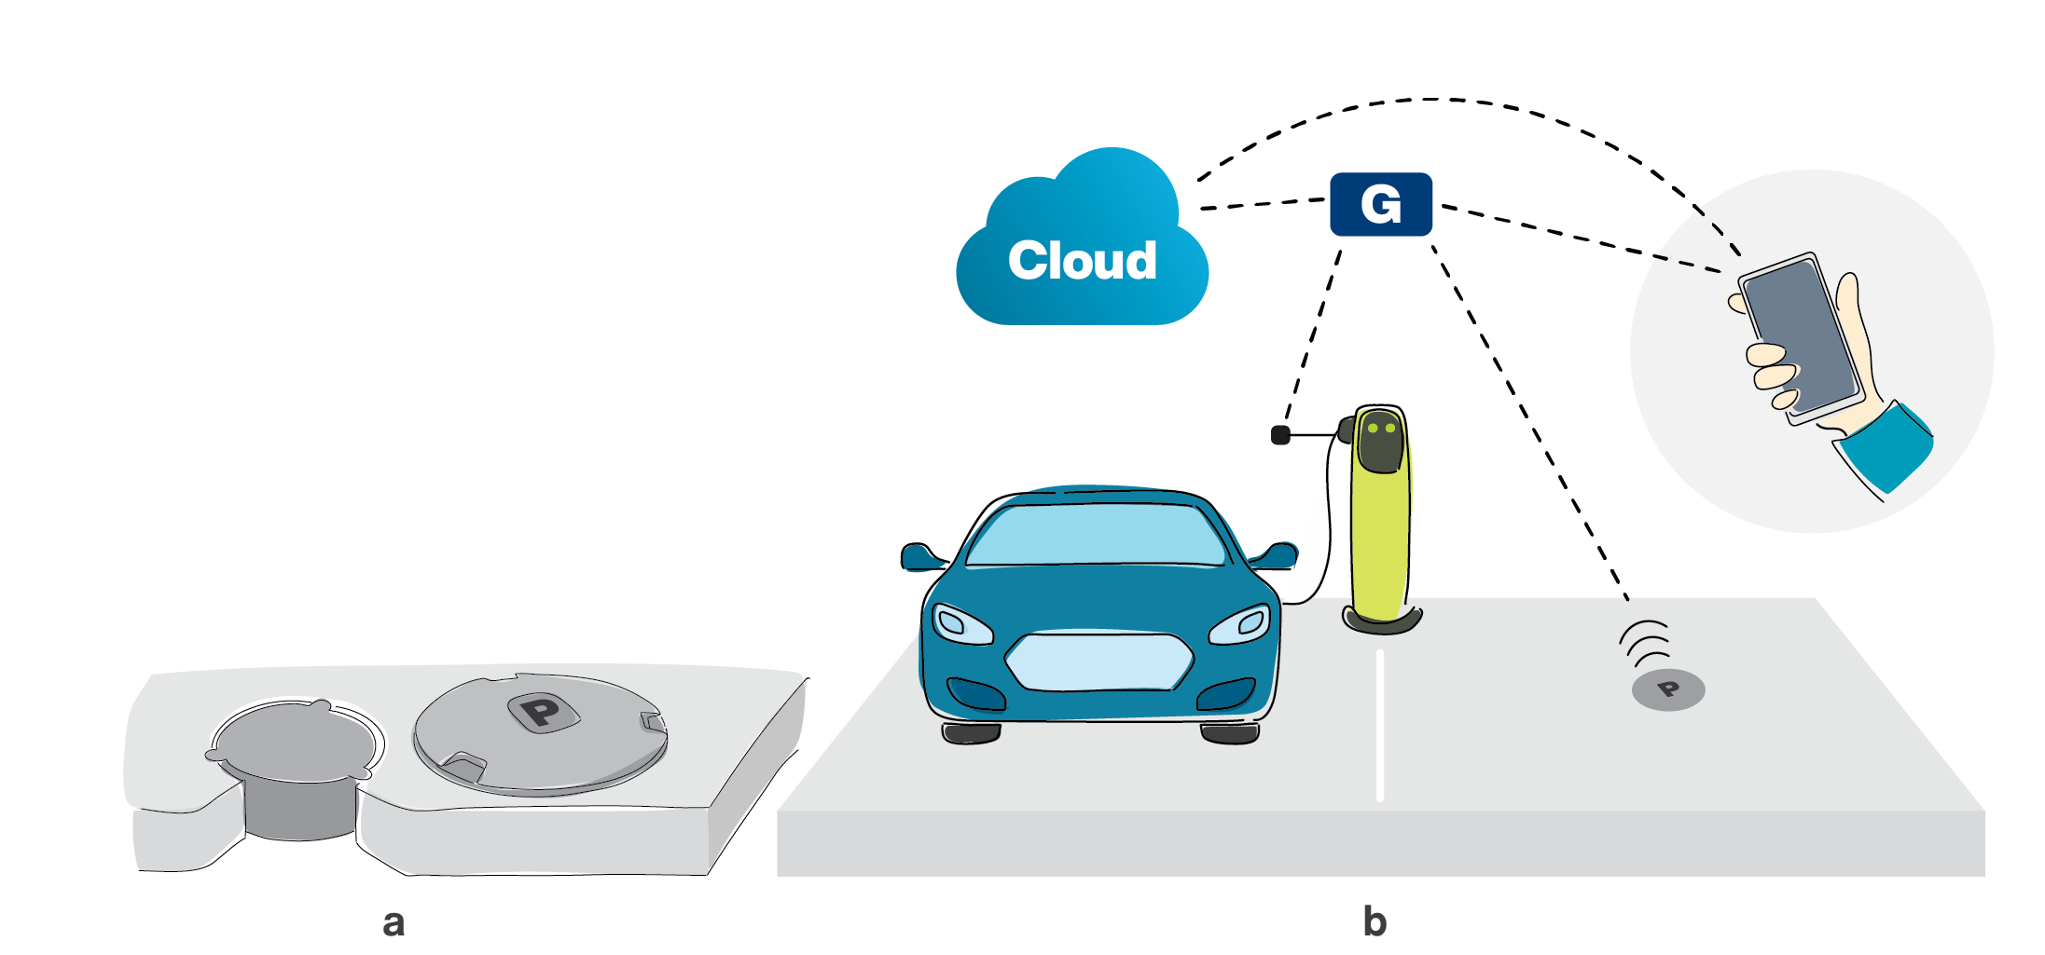
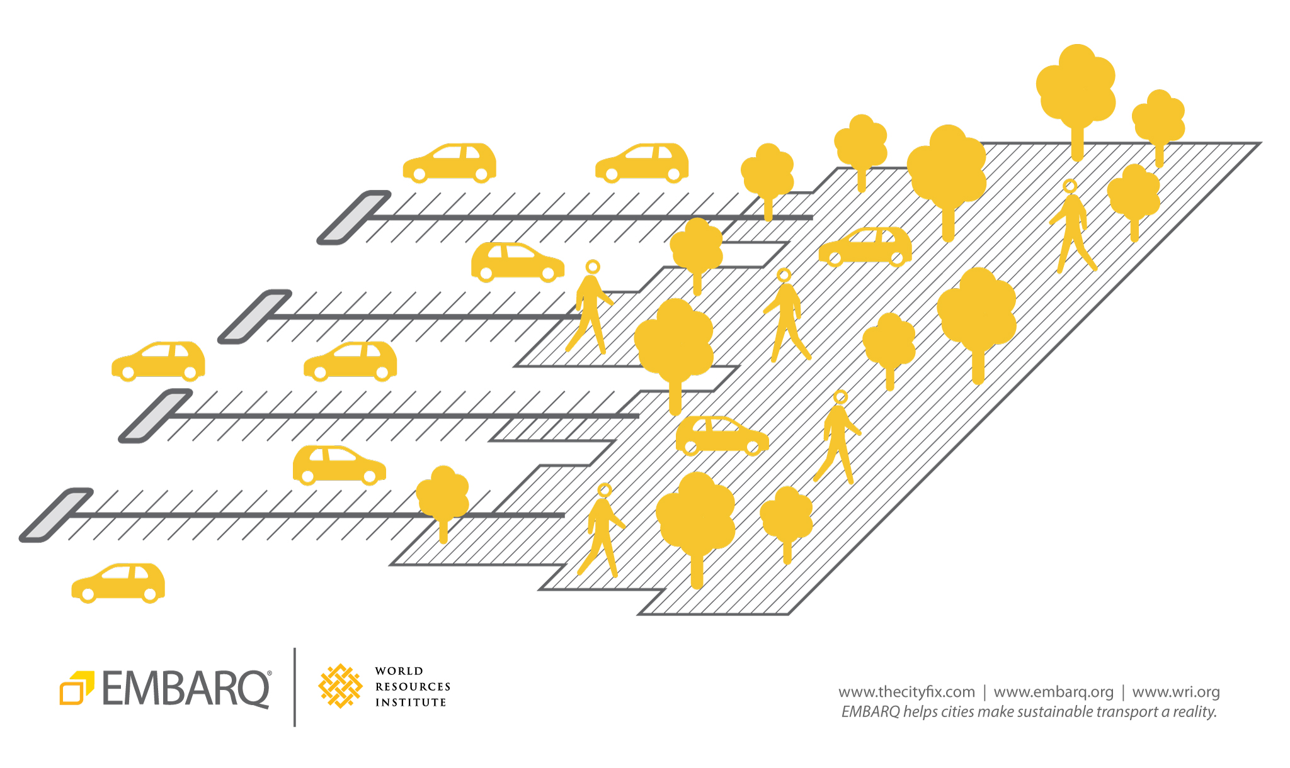
Abstract
Raspberry Pi is a miniature computer which has the adaptability with sensors.
The automated car parking system uses the Raspberry Pi. This work proposes an automated car parking system that uses infrared sensors.
The infrared sensor senses the movement of the vehicle and transmits the signal to the Pi.
LED display is installed at the main entrance of the parking area to provide enough information about slot availability.
In a real-time scenario, the proposed work can be enhanced further for multiple levels containing n number of slots with multiple Raspberry Pi.

Slide 4
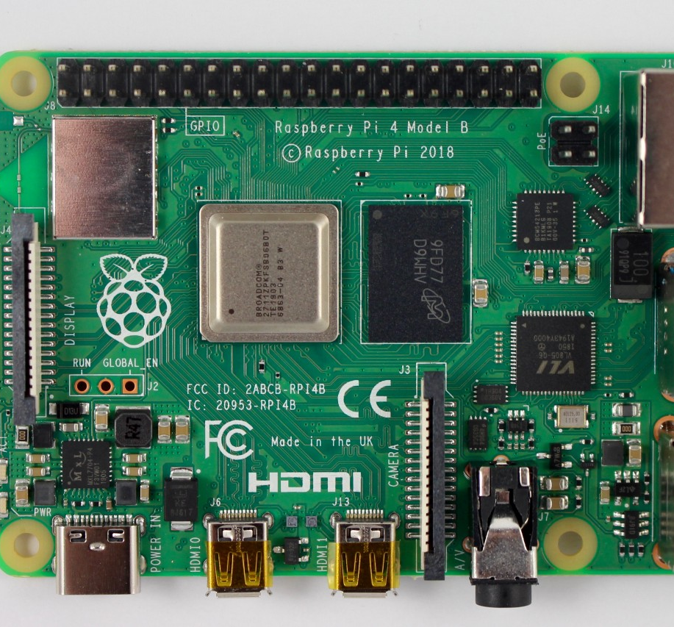
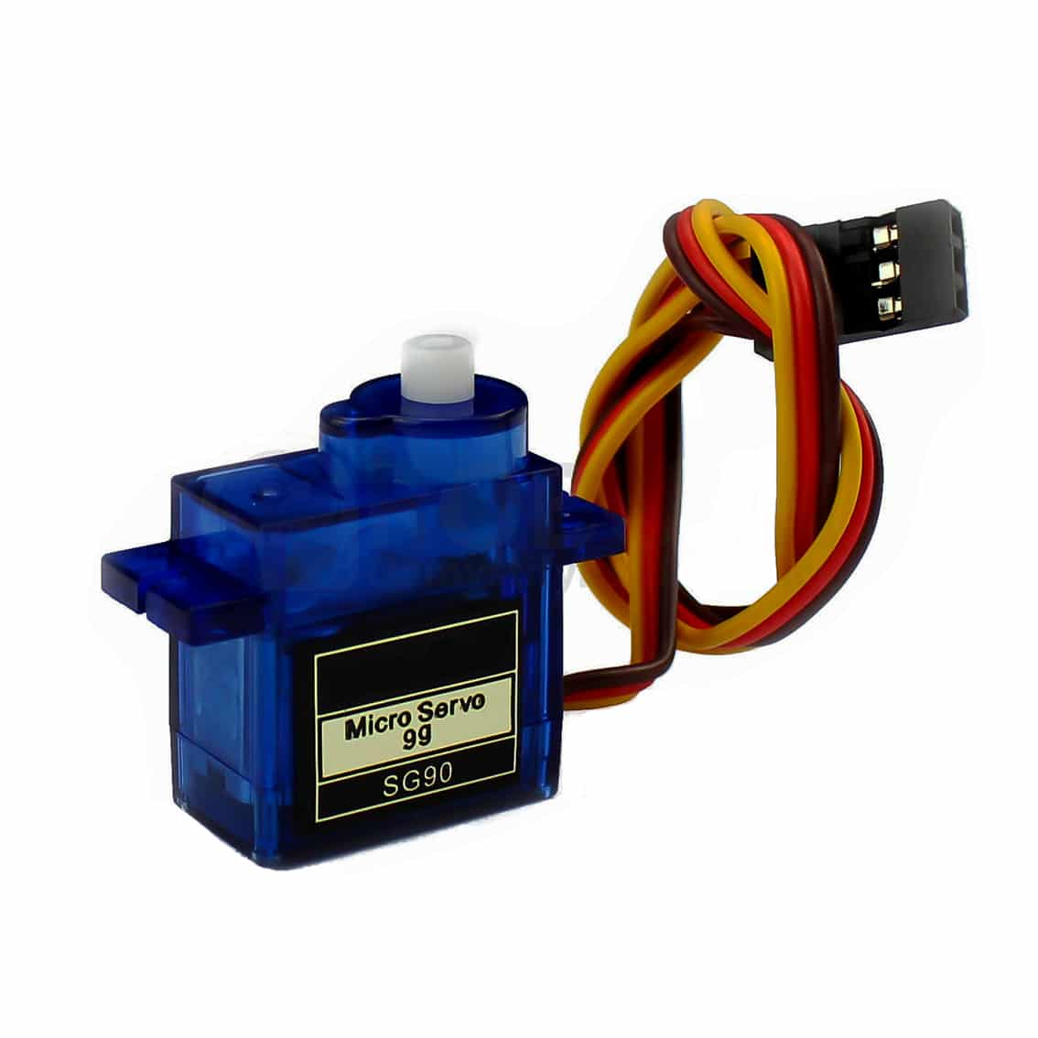
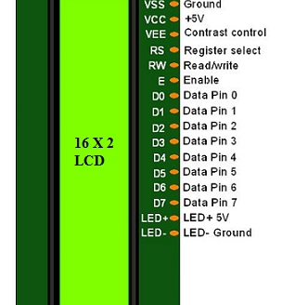
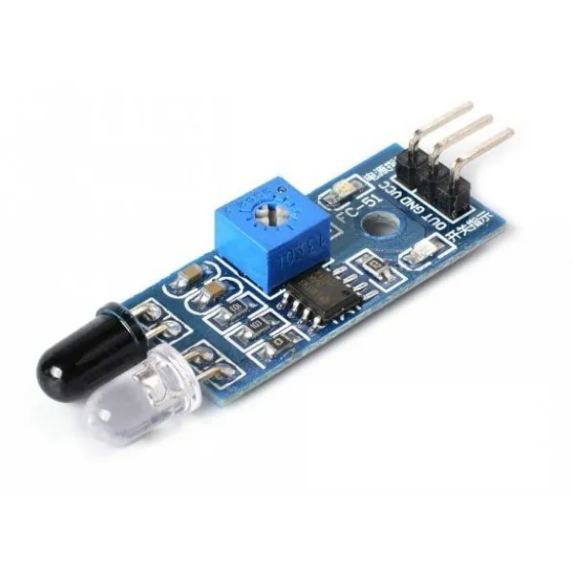
Hardware Components
Infrared (IR) Photoelectric Sensors
Servo Motor
Raspberry Pi 3
LCD Display – 16 X 2 Alphanumeric

Slide 5
Components
Hardware | Software Applications & Online Services | Hand Tools & Fabrication Machines
Raspberry Pi 3 – Adapter and HDMI Cable | Thonny Integrated Development Environment | Soldering Iron (Generic)
Two IR Photoelectric Sensor Module | Python 3 | Solder Wire, Lead-Free
Standard LCD Display – 16 X 2 Alphanumeric | Adafruit IO Cloud Service | Solder Flux, Soldering
Servo Motor | VNC Viewer (Optional)
Bread Board & Connecting Jumper Wires

Slide 6
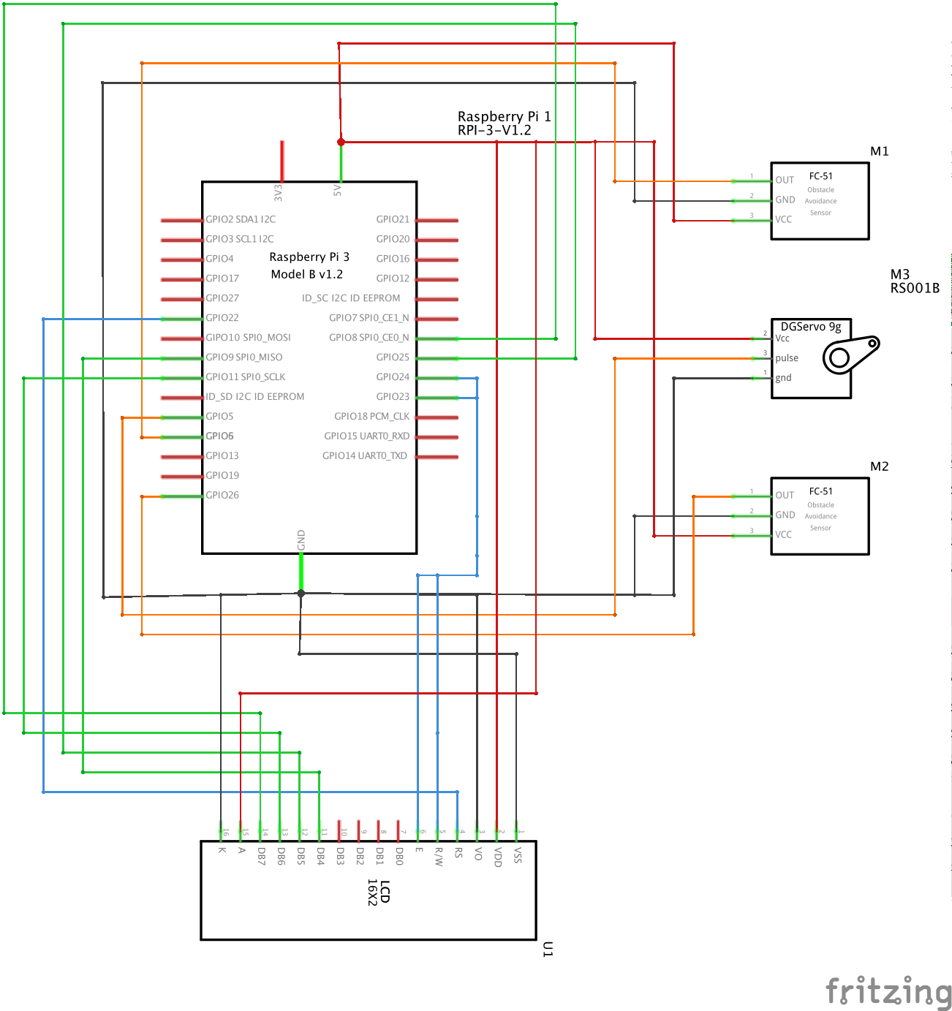
Block Diagram

Slide 7
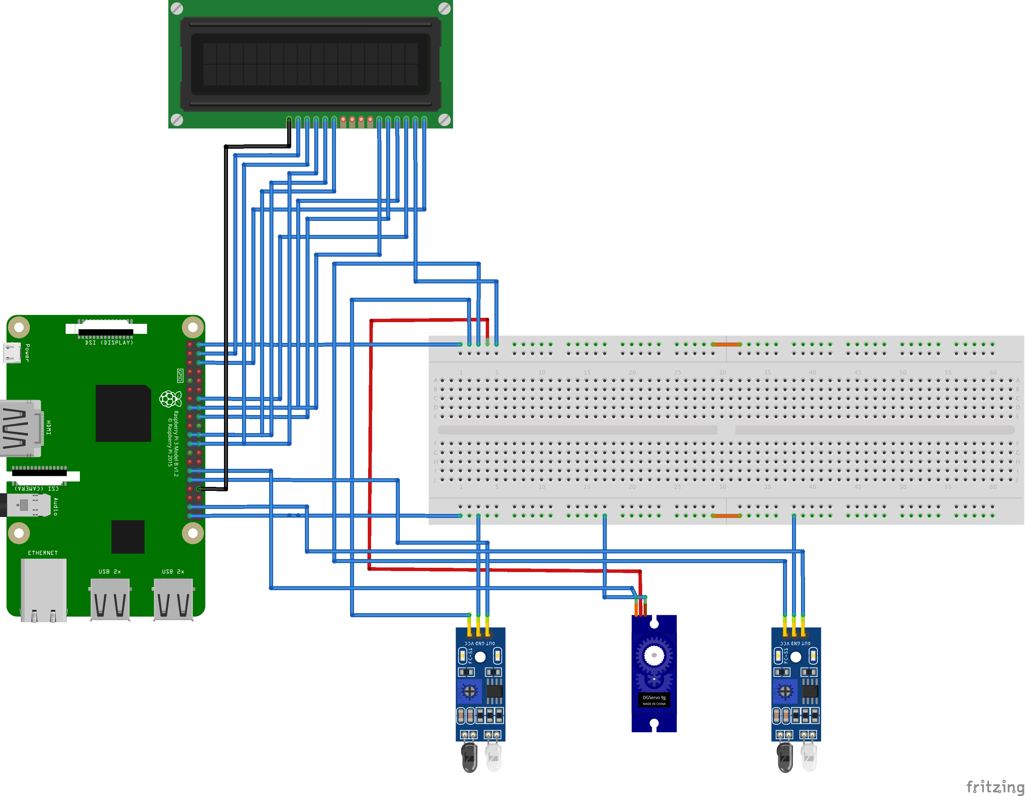
Circuit Diagram
At the entrance, the IR sensor detects the presence of a car. Based on the availability of the slots, an appropriate message is displayed in the LED display.
The IR sensor checks the status of the slots and sends the availability details to the main control unit, at the entrance which is connected to a single network.
When the IR Sensor detects a car entering or leaving the parking area, the number plate of the car is stored in the database online and the same is displayed on the LCD module for the public.

Slide 8
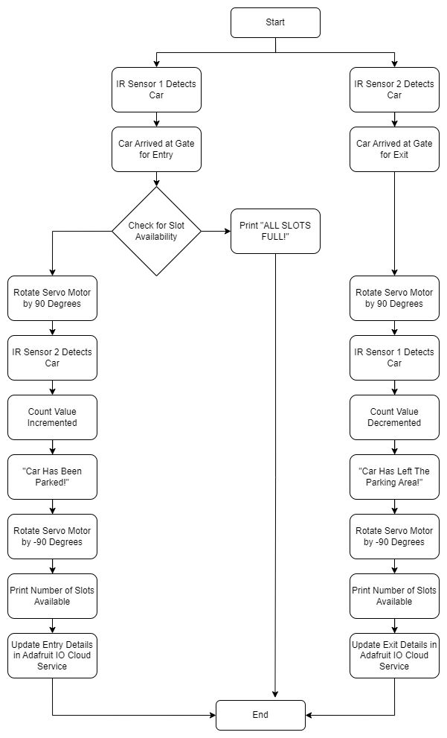
Working Flow Chart

Slide 9
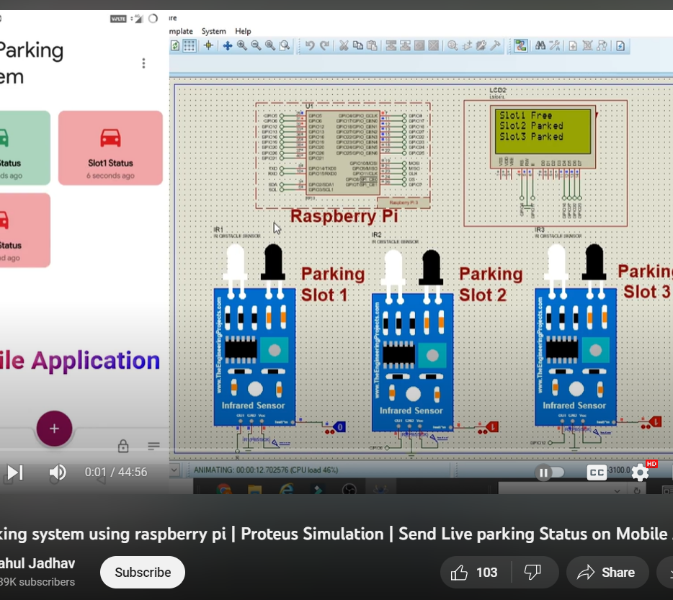
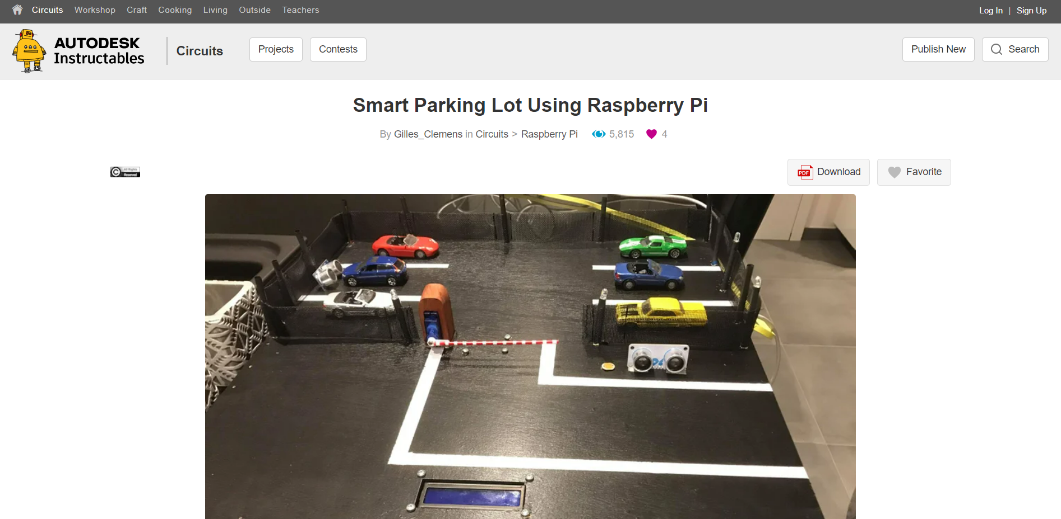
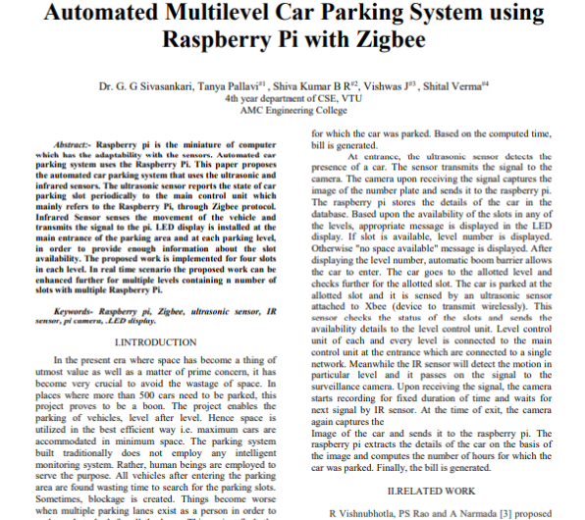
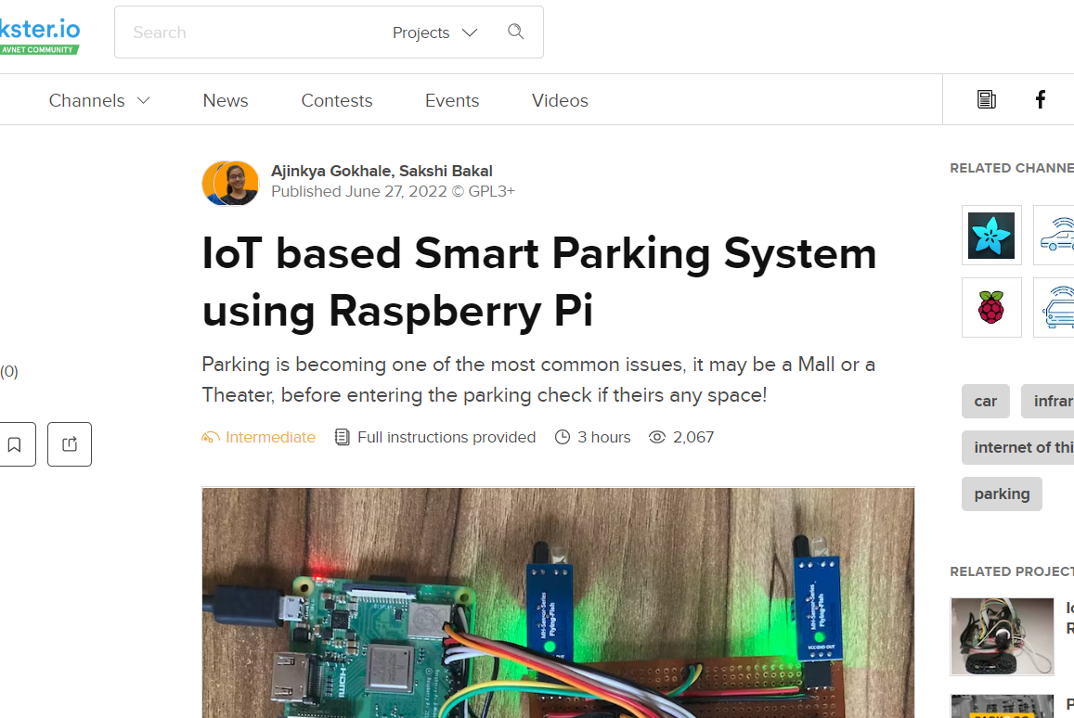
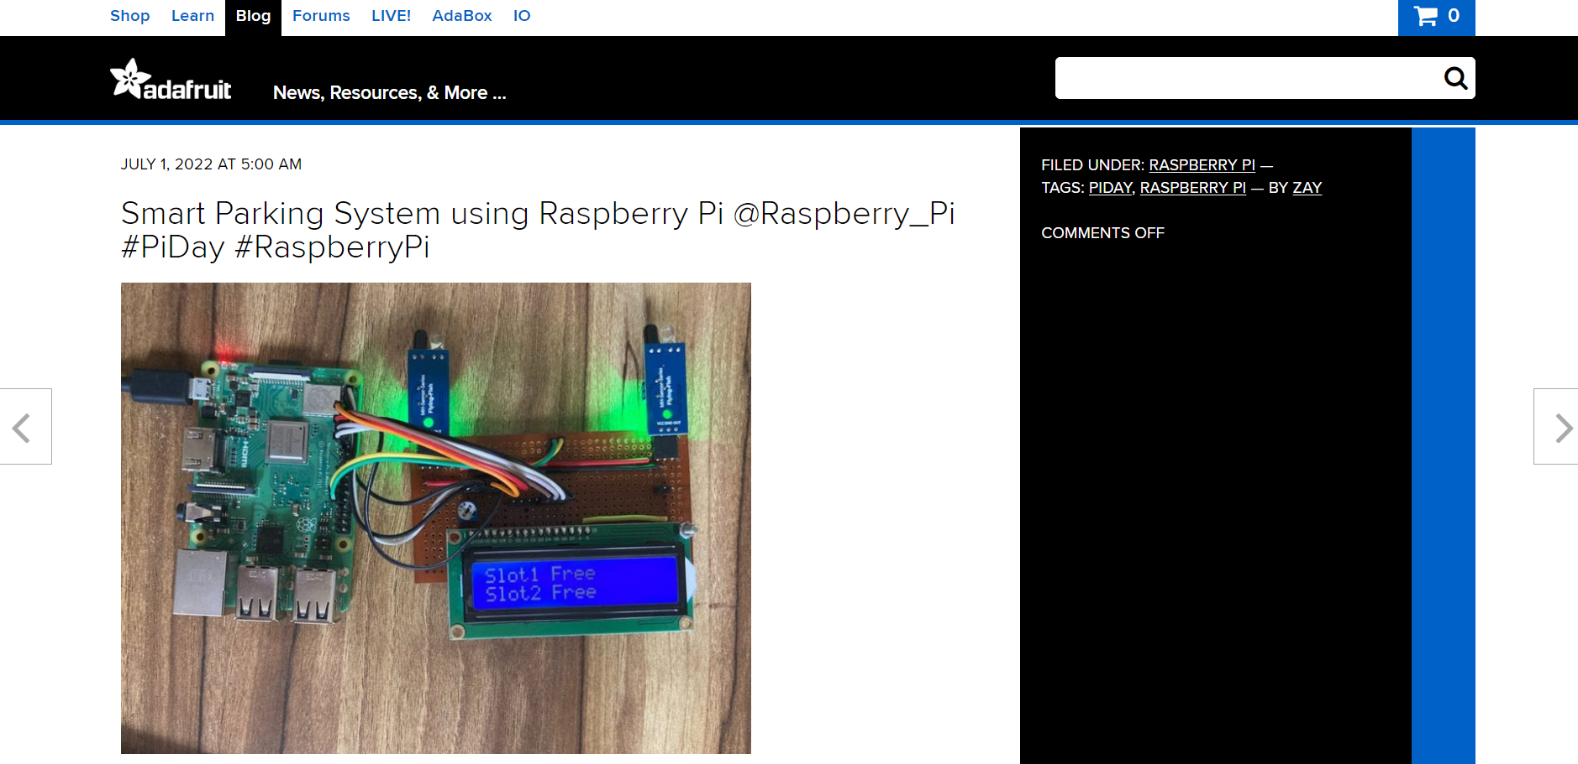
References
Automated Multilevel Car Parking System using Raspberry Pi with Zigbee, Dr G. G Sivasankari, Tanya Pallavi, Shiva Kumar B R, Vishwas J, Shital Verma, International Journal of Engineering Research & Technology (IJERT), ICACT – 2016 Conference Proceedings, ISSN: 2278-0181
IoT-based Smart Parking System using Raspberry Pi – https://www.hackster.io/ajinkyagokhale/iot-based-smart-parking-system-using-raspberry-pi-c7b2dc
Smart Parking Lot Using Raspberry Pi – https://www.instructables.com/Smart-Parking-Lot-Using-Raspberry-Pi/
Smart Parking System using Raspberry Pi – https://blog.adafruit.com/2022/07/01/smart-parking-system-using-raspberry-pi-raspberry_pi-piday-raspberrypi/
Car Parking System Using Raspberry Pi – https://www.youtube.com/watch?v=w-9ddDrOlew&ab_channel=RahulJadhav

